Slide 1


Changes for market participants
after Core FB MC Go-Live

Slide 2

CONTENTS
Summary of changes with an impact on market participants (MPs)
Description of changes
Changes in publication of information for Day-Ahead Market
Changes in documentation

Slide 3
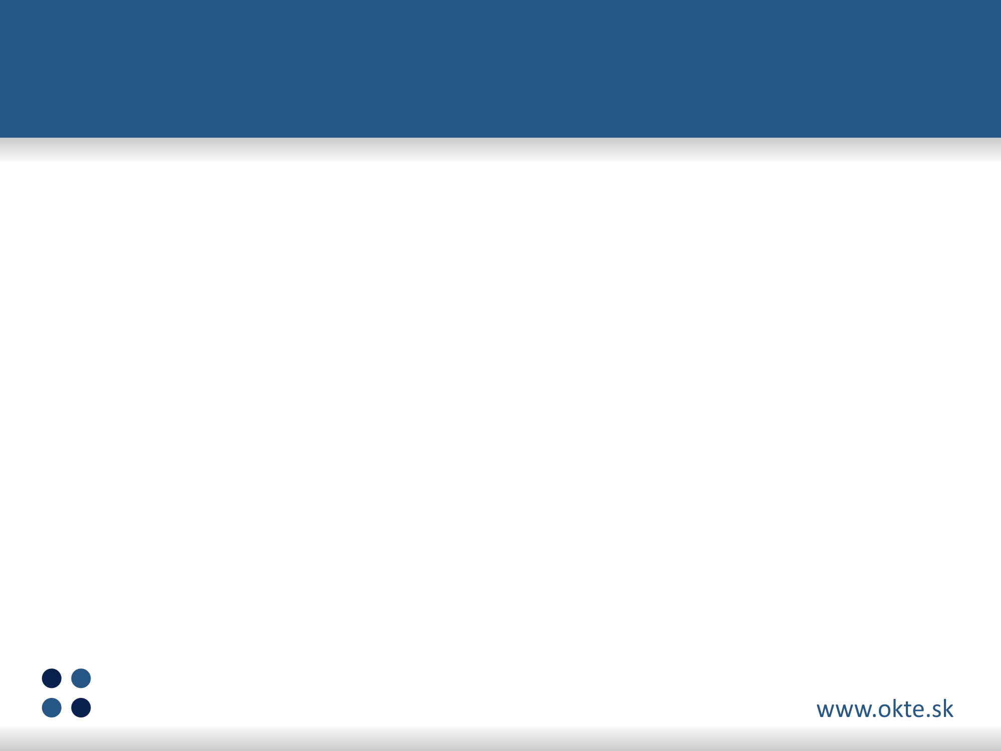

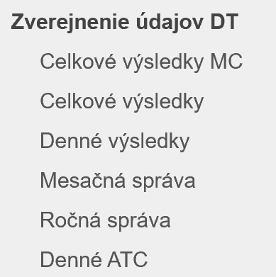
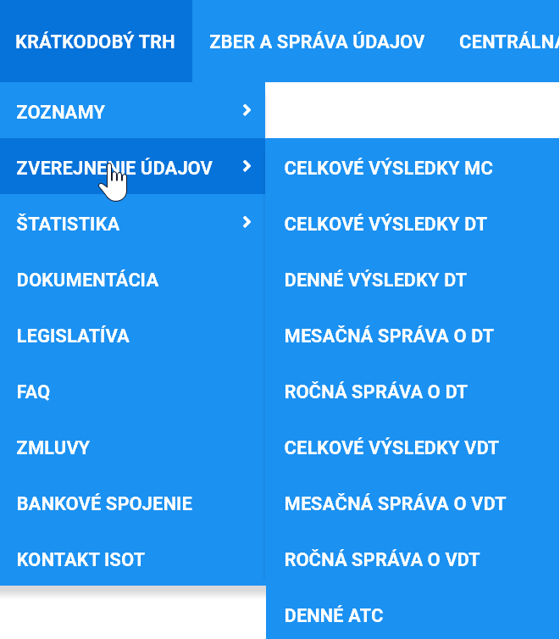
Summary of changes with an impact on market participants (MPs)
Orders for Day-Ahead Market (DAM)
Change of principle in curtailment of traded volume
External interfaces for MPs
Changes in publication of information for Day-Ahead Market (DAM)
Changes in documentation
Orders DAM
Publication of DAM results
External interfaces

Slide 4
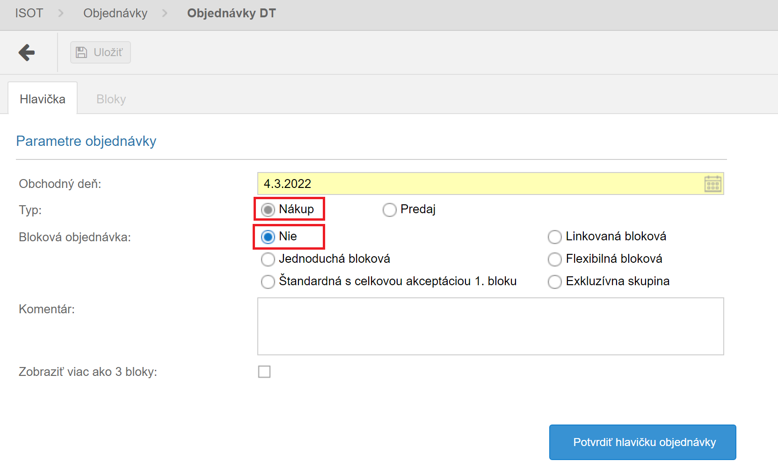
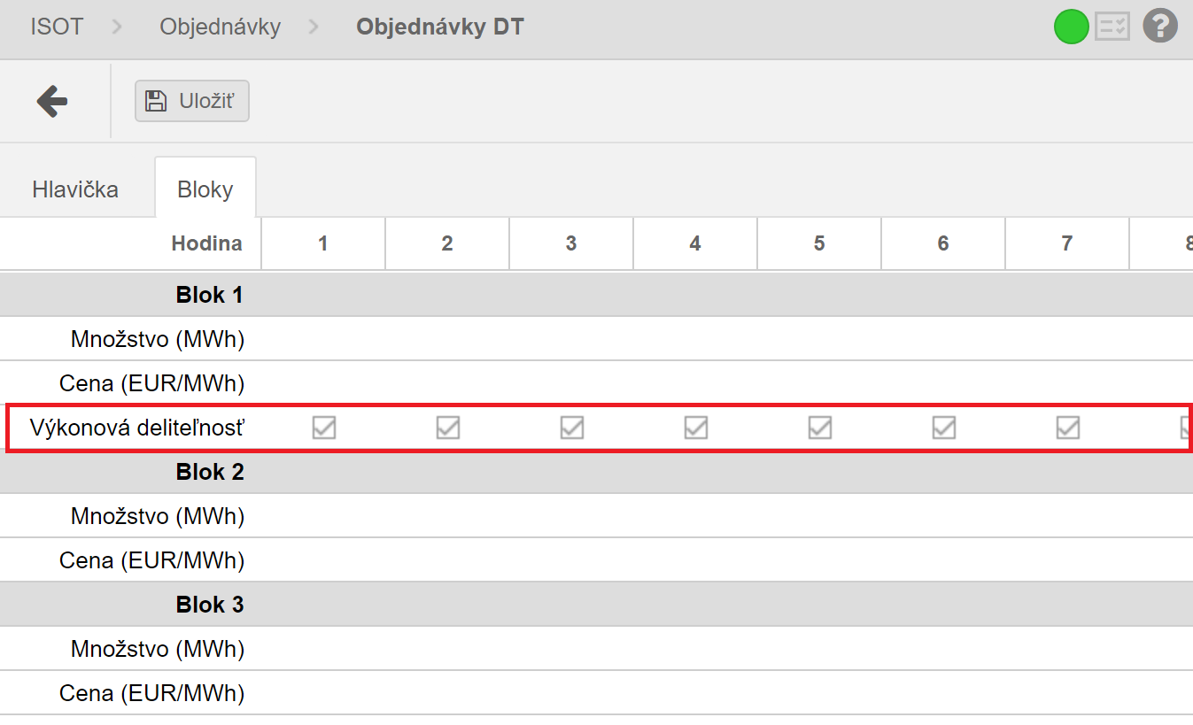
Orders for Day-Ahead Market
Expansion of the existing order portfolio
As part of the purchase order of the Standard type (block = No), the Production Indivisibility functionality will be supported
The functionality will be the same as it currently is available for sales orders

Slide 5
Change of principle in curtailment of traded volume
With the launch of the Core FB MC project, OKTE, a.s. will proceed to change the principle of order selection for the curtailment of traded volume
The new criterium will be the proximity to the marginal price in a given period
This change will also be included in the new Operation Order of OKTE, a.s.

Slide 6
External interfaces for MPs
In the context of external interfaces, there will be a change that will disable the availability of cross-border capacities for a business day operated under the CORE regime
In connection with this change, it is not necessary to modify the interfaces within the internal systems of market participants, but it will be necessary for the market participants to ensure the acquisition of cross-border capacities from the Publication tool on JAO (https://publicationtool.jao.eu/core)

Slide 7
Changes in publication of information for DAM 1/4
Change in terminology from ATC (Available Transfer Capacity) to CZC (Cross-Zonal Capacity)
Renaming of the subpage „Daily ATC“ to „Daily CZC“ on the XMtrade®/ISOT portal and on OKTE website
The changes for the Core FB MC project also include a change in the concept of sections on the OKTE website with public results, within which the subpages will be reorganized as follows:
Original subpages | New subpages
Total results MC | Total results DAM
Total results | Matching curves
Daily results | Indices DAM
Monthly report | Day-Ahead detailed overview
Yearly report
Daily ATC | Daily CZC

Slide 8
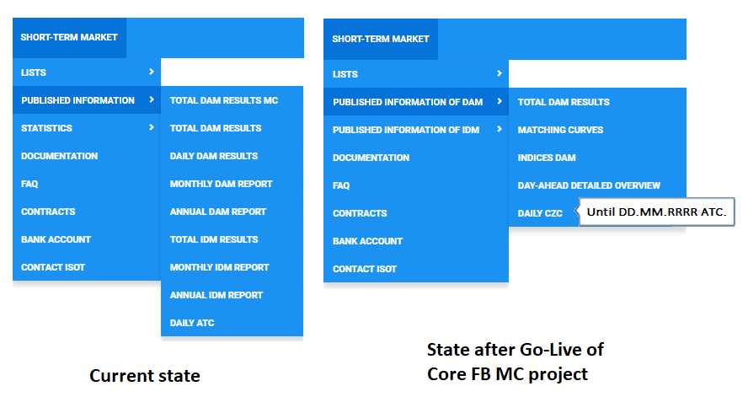
Changes in publication of information for DAM 2/4
Example of change in concept of subpages in navigation on OKTE website:
TEST environment of OKTE website: https://test.okte.sk (changes already available)

Slide 9
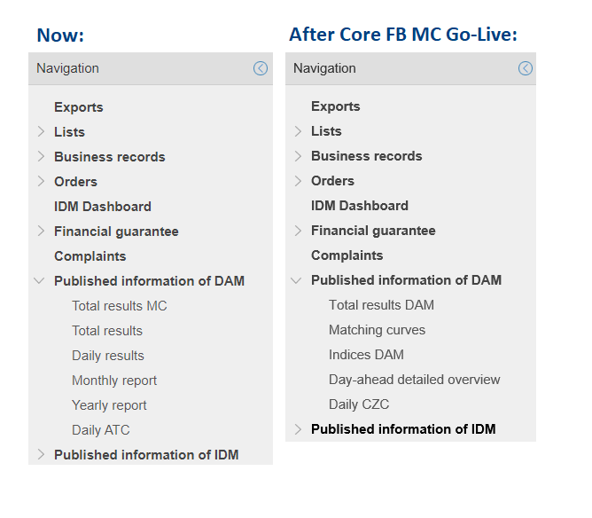
Changes in publication of information for DAM 3/4
Example of change in concept of subpages in navigation of XMtrade®/ISOT portal:
TEST environment of the portal: https://test-isot.okte.sk (changes already available)

Slide 10
Changes in publication of information for DAM 4/4
OKTE, a.s. will no longer publish the available cross-border capacities at 9:30 on the XMtrade®/ISOT portal and on the OKTE website
The cross-border capacities will be made available on a daily basis at 10:30 on the JAO website, through the so-called Publication Tool (https://publicationtool.jao.eu/core)

Slide 11
Changes in documentation
Updated User Guide for Core FB MC project:
Updated Technical specification of external interfaces, v 1.14:
New Operation Order of OKTE, a.s. including changes for Core FB MC project (to be published in April 2022)

Slide 12


Additional questions will be answered at
OKTE, a.s.
Mlynské nivy 48 • 821 09 Bratislava
e-mail: dayahead@okte.sk

